Slide 1
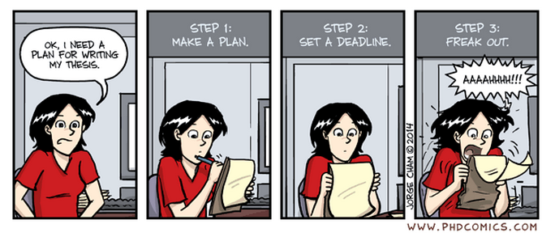

Birmingham International Academy
Thesis Writing for
Scientists and Engineers
Session 4: Results & Discussion
Tutor’s name: Jane Sjoberg j.e.sjoberg@bham.ac.uk
Please sit near other people

Slide 2

Where do you expect to find the Results & Discussion?

Slide 3
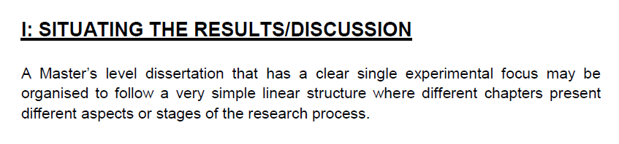
Read the example from Metallurgy and Materials

Slide 4
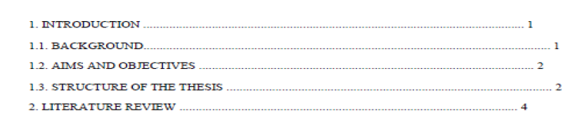
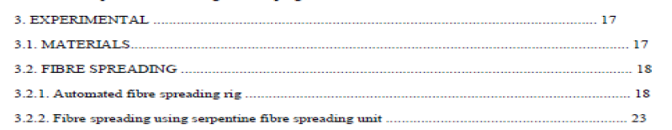
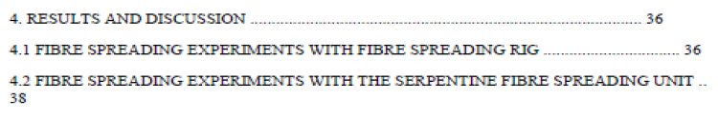
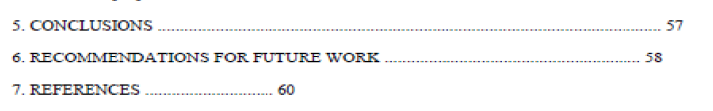

Slide 5
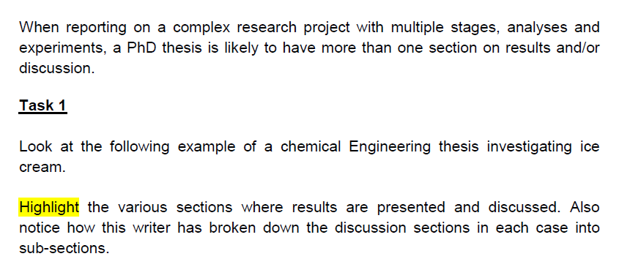
PhD theses are more varied

Slide 6
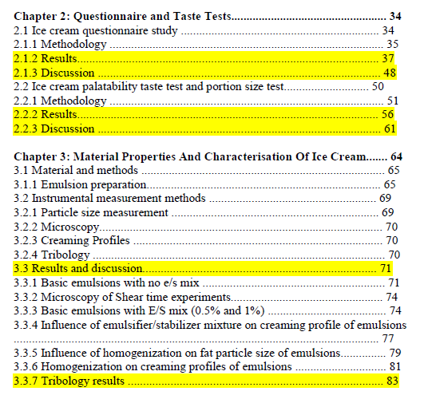

Slide 7
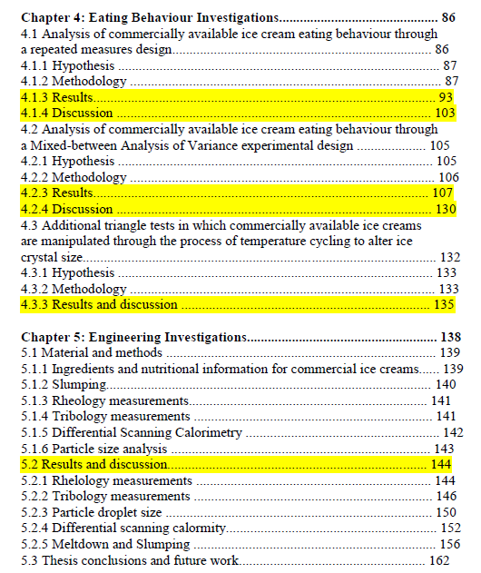

Slide 8
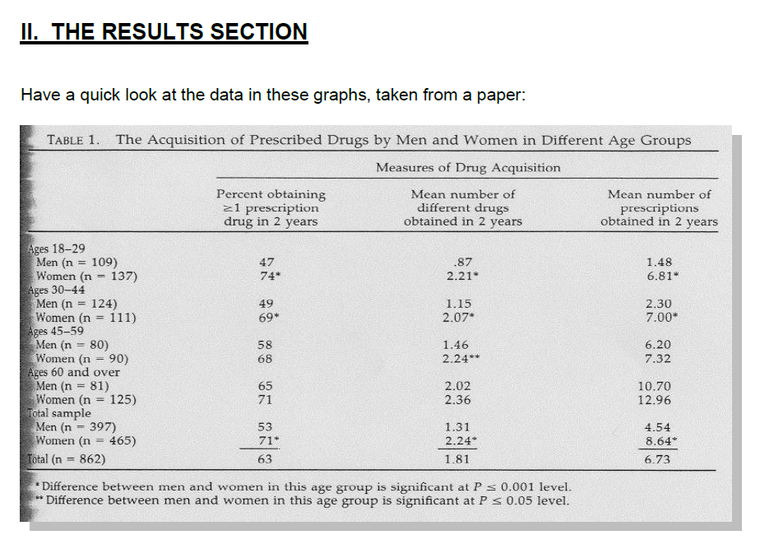
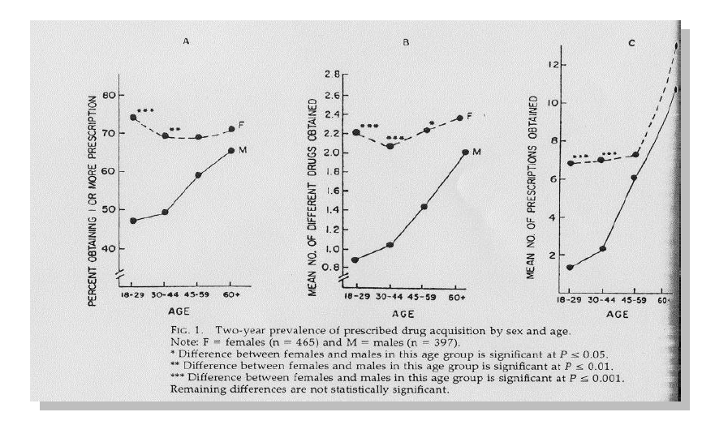

Slide 9
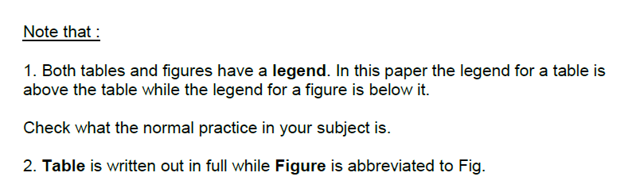

Slide 10
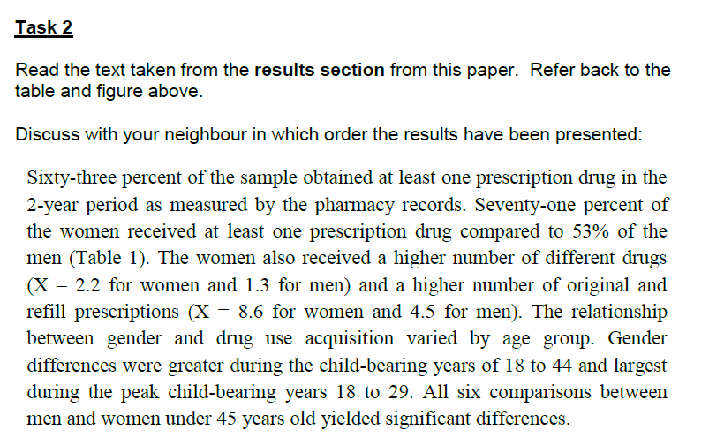
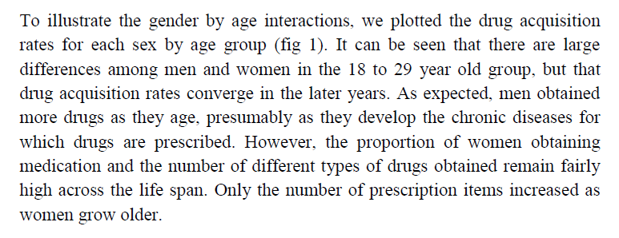

Slide 11
The writers chose to present the results in the following order:
1. total percentage men and women (Table 1, column 1, bottom)
2. total percentage women (column 1)
3. total percentage men (column 1)
4. mean number (different drugs) women (column 2)
5. mean number (different drugs) men (column 2)
6. mean number (prescriptions) women (column 3)
7. mean number (prescriptions) men (column 3)
8. age group (rows 1-4)
9. age group 18-29 (Table 1, rows 1-2; Fig. 1)
10. the later years (Table 1, other rows; Fig 1.)
11. life span (Table 1, Fig. 1)
The results went from the general to the specific and back. Not every single result was given, but the important categories were discussed.

Slide 12
Presentation of Results
Result 1 General
Sixty-three percent of the sample obtained at least one prescription drug in the 2-year period as measured by the pharmacy records.
Seventy-one percent of the women received at least one prescription drug compared to 53% of the men (Table 1). The women also received a higher number of different drugs (X = 2.2 for women and 1.3 for men) and a higher number of original and refill prescriptions (X = 8.6 for women and 4.5 for men).
Result 1 Detailed
The relationship between gender and drug use acquisition varied by age group.
Result 2
Gender differences were greater during the child-bearing years of 18 to 44 and largest during the peak child-bearing years 18 to 29. All six comparisons between men and women under 45 years old yielded significant differences.
Result 2
Basic details
To illustrate the gender by age interactions, we plotted the drug acquisition rates for each sex by age group (fig 1). It can be seen that there are large differences among men and women in the 18 to 29 year old group, but that drug acquisition rates converge in the later years. As expected, men obtained more drugs as they age, presumably as they develop the chronic diseases for which drugs are prescribed. However, the proportion of women obtaining medication and the number of different types of drugs obtained remain fairly high across the life span. Only the number of prescription items increased as women grow older.
Result 2 More
Detailed

Slide 13

A QUICK COMPETITION

Slide 14

Talk about British newspapers
What’s the difference between a quality/popular/mid-market newspaper?
Are all UK newspapers published every day?
Which papers do you read?

Slide 15
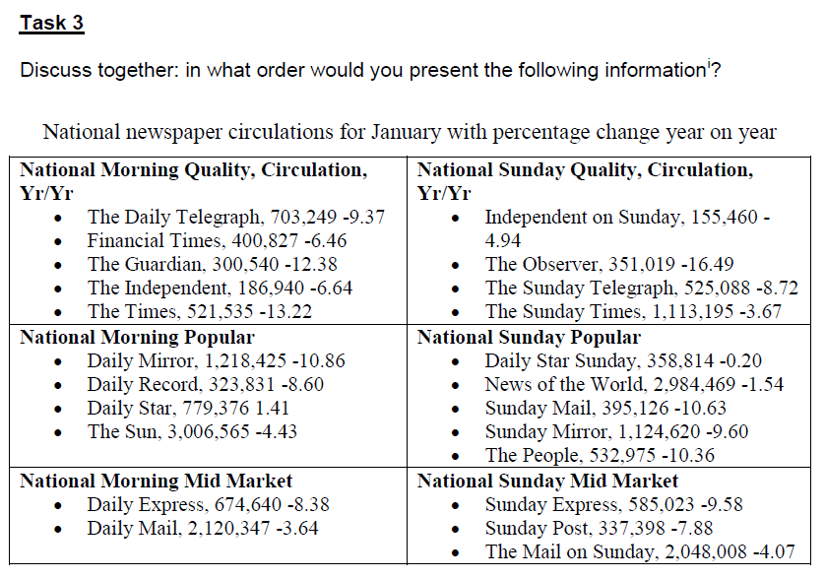

Slide 16
Suggestion:
The percentage change (with one exception – Daily Star - all newspaper sales are down).
A comparison between morning and Sunday papers (no clear trends).
A comparison in sales of the different types of papers (in order of sales: popular, mid-market, quality).

Slide 17
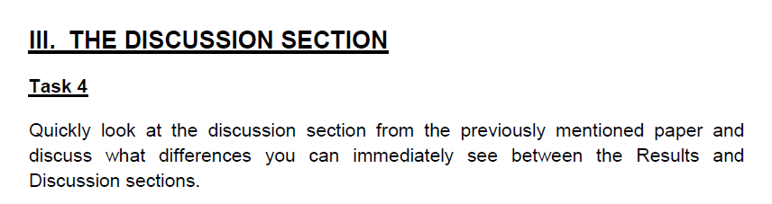
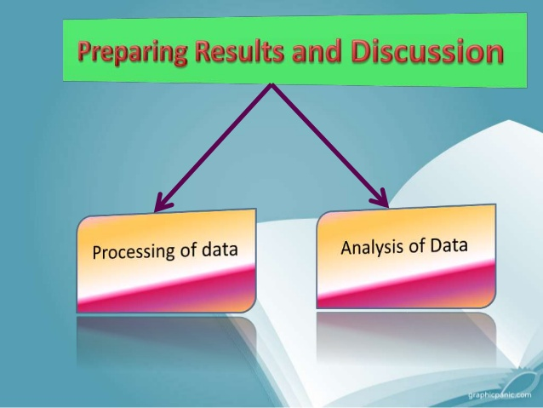

Slide 18
How does a ‘discussion’ differ from ‘results’?
No numbers, percentages or other statistics are given, but there is more detail and analysis.
Comparisons are made to other studies (similarities, differences, importance of the research...).
The language indicates that a discussion section is evaluative

Slide 19
Women obtain more prescribed drugs and prescriptions, but only in some age groups and drug categories. Sex differences are of greatest magnitude in the child-bearing years and in the drug categories that are used to prevent or treat female-specific conditions. The disproportionate use of other prescribed drugs by women also can be attributed to the higher use of drugs by the women who have experienced a full-term pregnancy, female-specific surgical procedures, or other sex-specific diagnoses or complaints (as recorded by the physician).
Explanation & Interpretation

Slide 20
The results reported here are similar to the findings of other reports based on more objective information. For example, Swedish reports based on pharmacy data show that the difference between male and female drug use in that country varies considerably from one drug class to another, with extremely large differences in the categories associated with women’s reproductive role and much smaller differences in the use of expectorants, bronchodilators, cardiovasculars, and other drugs having less association with women’s reproductive role. A recent US study based on detailed physician reports also showed that 5 of the 10 drugs most frequently ordered for 15 to 24-year old women related to women’s reproductive role, including two oral contraceptives, two prenatal vitamins, and a vaginal fungicide. Our drug use findings also are similar to findings concerning sex differences in physician utilization. For example, we have found that simply excluding women who gave birth during the study significantly narrowed sex, differences in use of outpatient facilities. Earlier studies seem to have substantially exaggerated the magnitude of sex differences in physician utilization and medication use and provide little basis to support the hypothesis of physician bias.
Comparisons
with other studies
Critical evaluation

Slide 21
Explanation & Interpretation
There are several possible reasons why we found only a slight sex difference in Psychotherapeutic drug use. Unlike many studies documenting the higher use of psychotropic drugs among women, we avoided the use of self-report and proxy respondents. Second, our study was conducted in a rural and culturally homogeneous area that is served by a highly regarded and accessible multispecialty group practice and its affiliates. It is possible that psychosocial factors may play a much more important role in other geographic areas or among other groups of patients and physicians. For example, we have noted a significant association between reported psychological distress and the use of nonprescription meditation in this population. One plausible interpretation for these findings is that the people in this area are more stoic and less likely to use the medical care system in response to psychological distress, preferring self-medication and other nonmedical methods of coping.
Comparisons
with other studies/critical evaluation
Explanation & Interpretation

Slide 22
It is important to note other limitations of investigations of this type. First, the sample was small, and there was some attrition as a result of patient and pharmacist refusal. However, we have no reason to believe that our conclusions were substantially affected by this attrition. Most important, we had no fully objective assessment of physical condition despite access to medical records. Nor did we evaluate the appropriateness of the drugs that were prescribed. Therefore, we cannot exclude the possibility that younger men had many problems that went unrecognized and untreated. Nor can we say that the women really needed all the drugs they received, that the disproportionate use of drugs among young women was solely related to their reproductive role, or that psychosocial factors were irrelevant to the ways in which their care was delivered. Despite all of the adjustments, the female rate of drug acquisition remains slightly higher, especially in younger age groups. Thus, it is likely that both physical and psychosocial factors influence the way in which men and women perceive, label and respond to their needs and symptoms, and the way in which physicians respond to their patients. However, as researchers continue to investigate these issues, it is critical that they collect more objective and detailed data and that they disaggregate the types of patients, diseases, symptoms and drugs being investigated.
Limitations and their interpretation

Slide 23
It is important to note other limitations of investigations of this type. First, the sample was small, and there was some attrition as a result of patient and pharmacist refusal. However, we have no reason to believe that our conclusions were substantially affected by this attrition. Most important, we had no fully objective assessment of physical condition despite access to medical records. Nor did we evaluate the appropriateness of the drugs that were prescribed. Therefore, we cannot exclude the possibility that younger men had many problems that went unrecognized and untreated. Nor can we say that the women really needed all the drugs they received, that the disproportionate use of drugs among young women was solely related to their reproductive role, or that psychosocial factors were irrelevant to the ways in which their care was delivered. Despite all of the adjustments, the female rate of drug acquisition remains slightly higher, especially in younger age groups. Thus, it is likely that both physical and psychosocial factors influence the way in which men and women perceive, label and respond to their needs and symptoms, and the way in which physicians respond to their patients. However, as researchers continue to investigate these issues, it is critical that they collect more objective and detailed data and that they disaggregate the types of patients, diseases, symptoms and drugs being investigated.

Slide 24
It is important to note other limitations of investigations of this type. First, the sample was small, and there was some attrition as a result of patient and pharmacist refusal. However, we have no reason to believe that our conclusions were substantially affected by this attrition. Most important, we had no fully objective assessment of physical condition despite access to medical records. Nor did we evaluate the appropriateness of the drugs that were prescribed. Therefore, we cannot exclude the possibility that younger men had many problems that went unrecognized and untreated. Nor can we say that the women really needed all the drugs they received, that the disproportionate use of drugs among young women was solely related to their reproductive role, or that psychosocial factors were irrelevant to the ways in which their care was delivered. Despite all of the adjustments, the female rate of drug acquisition remains slightly higher, especially in younger age groups. Thus, it is likely that both physical and psychosocial factors influence the way in which men and women perceive, label and respond to their needs and symptoms, and the way in which physicians respond to their patients. However, as researchers continue to investigate these issues, it is critical that they collect more objective and detailed data and that they disaggregate the types of patients, diseases, symptoms and drugs being investigated.

Slide 25
It is important to note other limitations of investigations of this type. First, the sample was small, and there was some attrition as a result of patient and pharmacist refusal. However, we have no reason to believe that our conclusions were substantially affected by this attrition. Most important, we had no fully objective assessment of physical condition despite access to medical records. Nor did we evaluate the appropriateness of the drugs that were prescribed. Therefore, we cannot exclude the possibility that younger men had many problems that went unrecognized and untreated. Nor can we say that the women really needed all the drugs they received, that the disproportionate use of drugs among young women was solely related to their reproductive role, or that psychosocial factors were irrelevant to the ways in which their care was delivered. Despite all of the adjustments, the female rate of drug acquisition remains slightly higher, especially in younger age groups. Thus, it is likely that both physical and psychosocial factors influence the way in which men and women perceive, label and respond to their needs and symptoms, and the way in which physicians respond to their patients. However, as researchers continue to investigate these issues, it is critical that they collect more objective and detailed data and that they disaggregate the types of patients, diseases, symptoms and drugs being investigated.

Slide 26
It is important to note other limitations of investigations of this type. First, the sample was small, and there was some attrition as a result of patient and pharmacist refusal. However, we have no reason to believe that our conclusions were substantially affected by this attrition. Most important, we had no fully objective assessment of physical condition despite access to medical records. Nor did we evaluate the appropriateness of the drugs that were prescribed. Therefore, we cannot exclude the possibility that younger men had many problems that went unrecognized and untreated. Nor can we say that the women really needed all the drugs they received, that the disproportionate use of drugs among young women was solely related to their reproductive role, or that psychosocial factors were irrelevant to the ways in which their care was delivered. Despite all of the adjustments, the female rate of drug acquisition remains slightly higher, especially in younger age groups. Thus, it is likely that both physical and psychosocial factors influence the way in which men and women perceive, label and respond to their needs and symptoms, and the way in which physicians respond to their patients. However, as researchers continue to investigate these issues, it is critical that they collect more objective and detailed data and that they disaggregate the types of patients, diseases, symptoms and drugs being investigated.

Slide 27
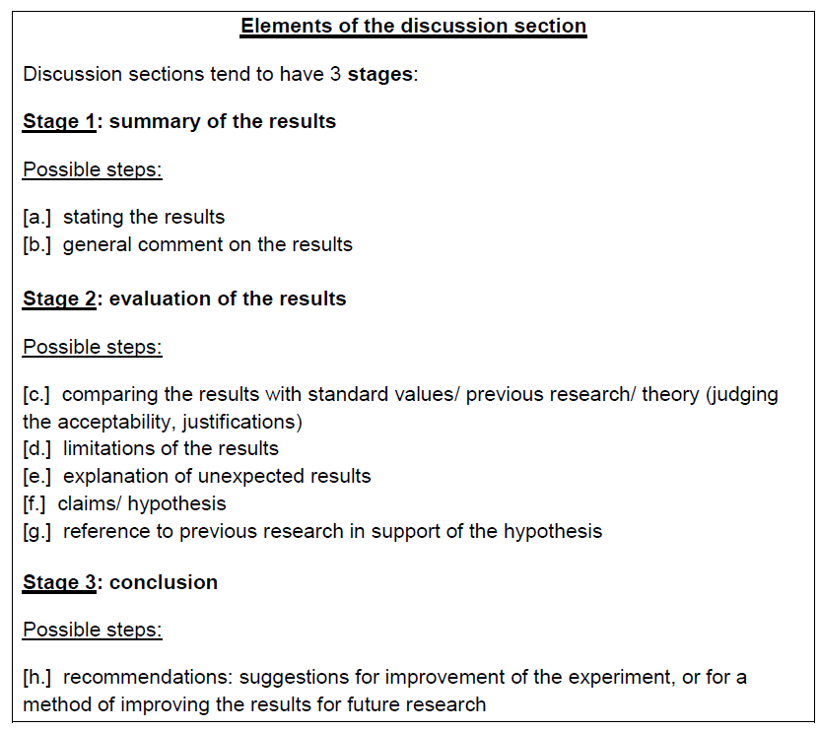
Remember that not all steps will be present and the order of the steps may be different! Some steps may be more fully developed than others.

Slide 28
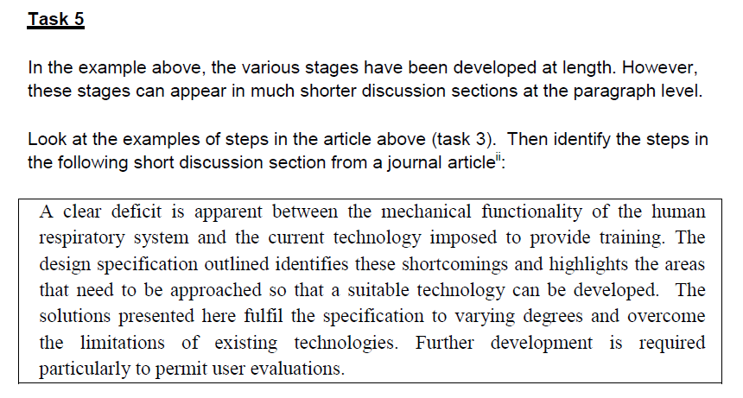

Slide 29
Possible solution:
Stating the results
General comment
(a) A clear deficit is apparent between the mechanical functionality of the human respiratory system and the current technology imposed to provide training. (b) The design specification outlined identifies these shortcomings and highlights the areas that need to be approached so that a suitable technology can be developed. (f) The solutions presented here fulfil the specification to varying degrees and overcome the limitations of existing technologies. (h/d) Further development is required particularly to permit user evaluations.
Evaluation: Claim
Limitations &
Recommendation

Slide 30

The language of comparison

Slide 31
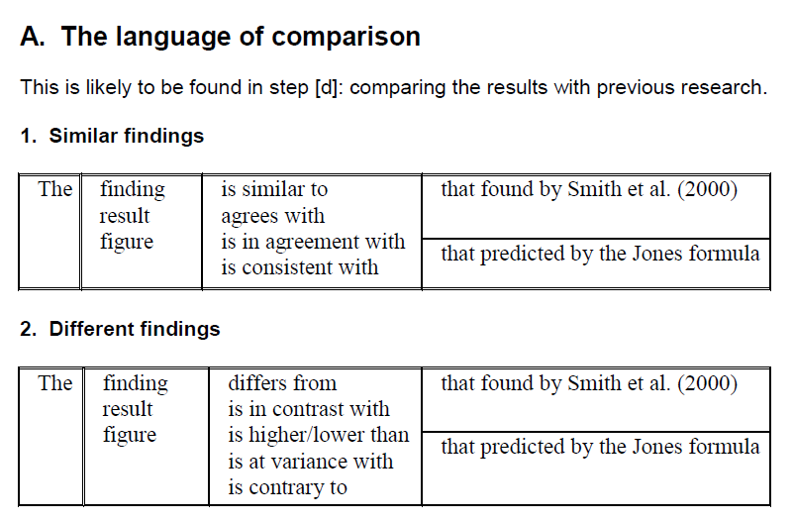

Slide 32
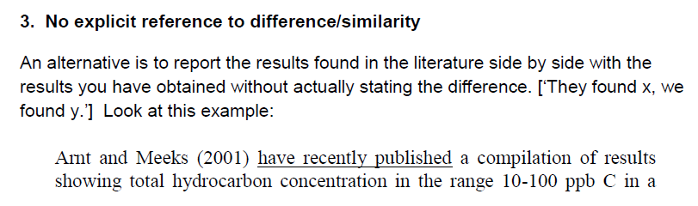
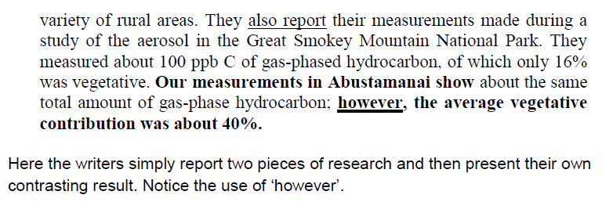
. However
; however
is however
can however be

Slide 33
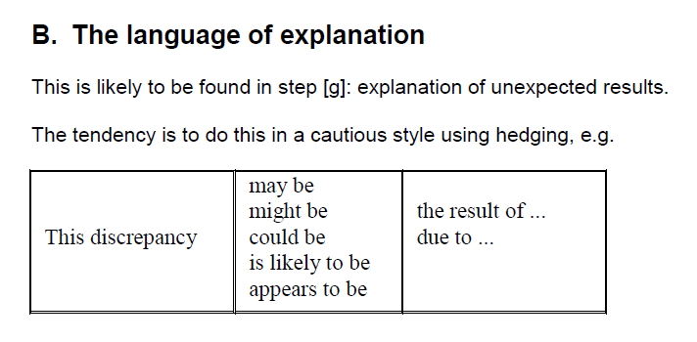

Slide 34
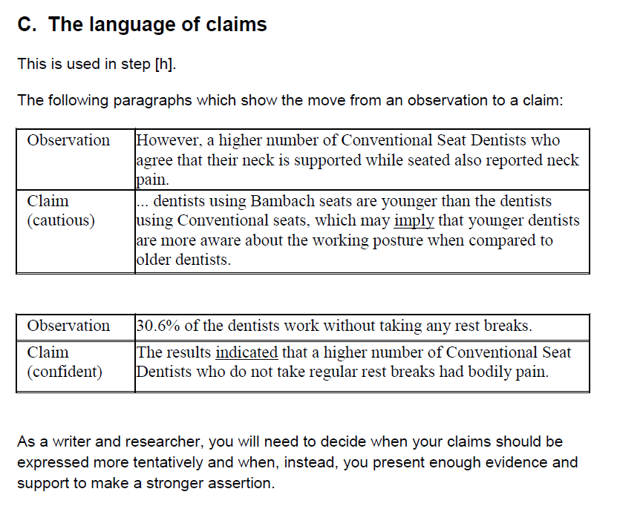

Slide 35
Be careful to avoid over-hedging or hedging in inappropriate places!
It is possible that psychosocial factors may play a much more important role in other geographic areas or among other groups of patients and physicians. ☺
It is possible that men may generally have greater muscle mass, chest, and shoulder girth than women. ☹
Men generally have…☺
Our results may show that this might be the right approach in the treatment of some cases.
Our results indicate that this is…☺

Slide 36

More on Reporting Verbs

Slide 37
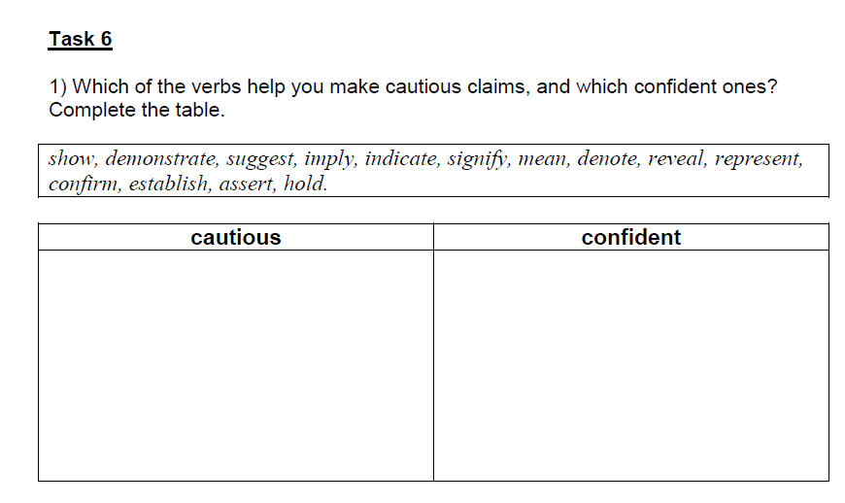
Claims and Stance

Slide 38
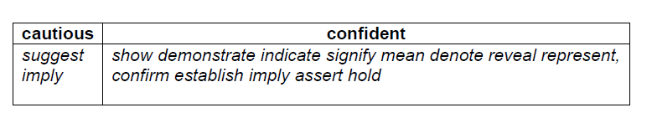
Key
Note that ‘imply’ has 2 meanings:
1. indicate the truth or existence of something by suggestion rather than explicit reference (cautious) e.g. This distance modulus would imply a main-sequence turn-off age of 12 Gyr, worsening the age discrepancy.
2. suggest as a logical consequence (confident) e.g. Although sediments become coarser near the top of the sequence, implying slightly shallower and more energetic conditions, our observations indicate that ....

Slide 39
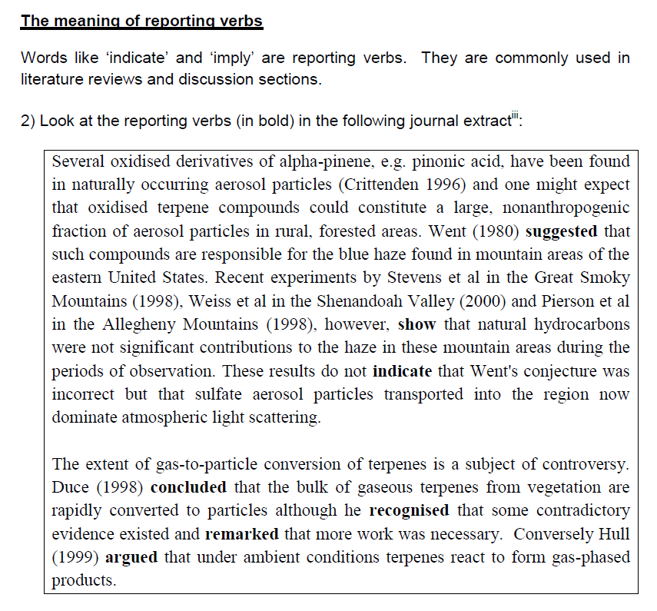

Slide 40
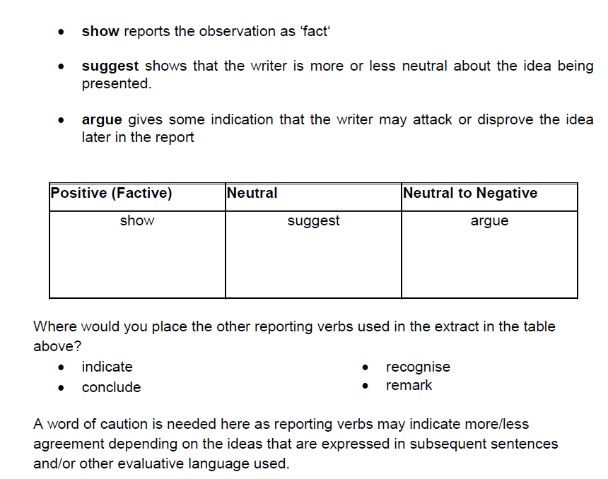

Slide 41
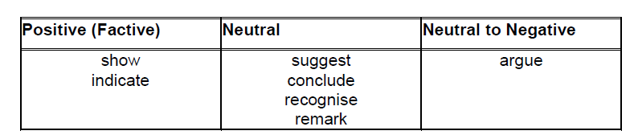
KEY

Slide 42
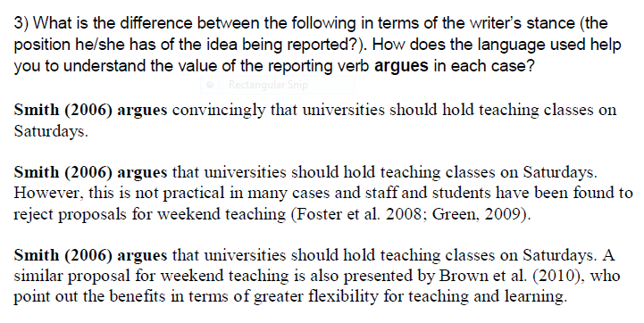

Slide 43
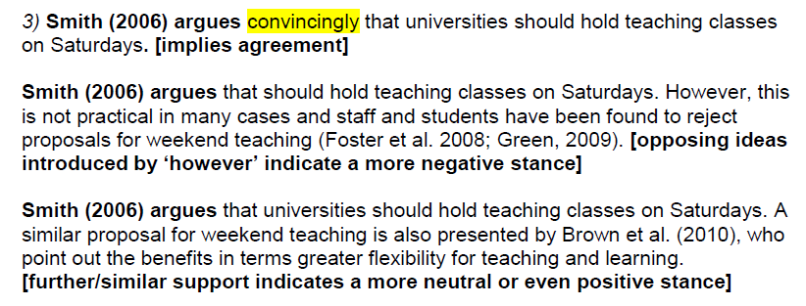
KEY

Slide 44
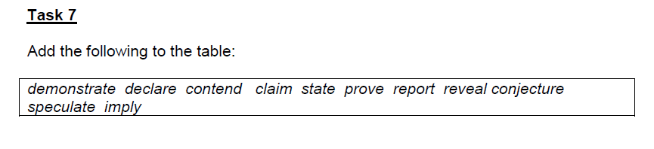
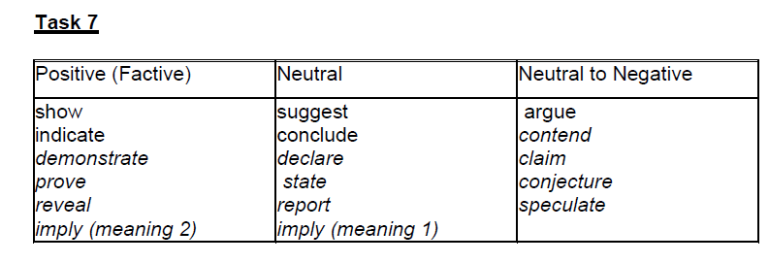

Slide 45

Homework: Check your answers in the Key
Find out about verbs and their meaning in different disciplines!

Slide 46

Extend your knowledge
Tonight, read some articles in your subject.
Look at verbs used for making claims in the Discussion section.
What verbs are used and how do they affect the strength of the claims?
What other words or phrases do writers use to make claims?

Slide 47
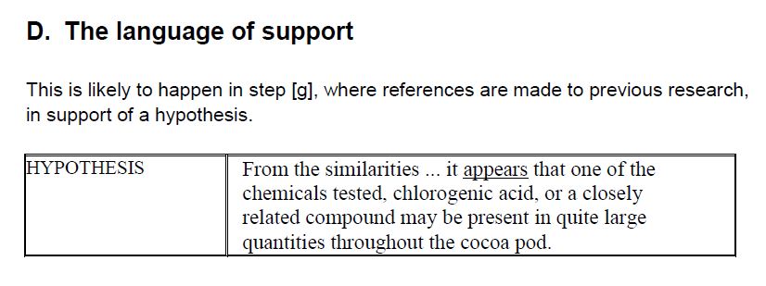
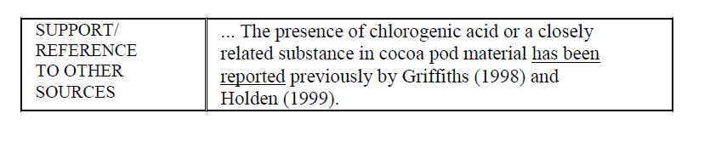

Slide 48
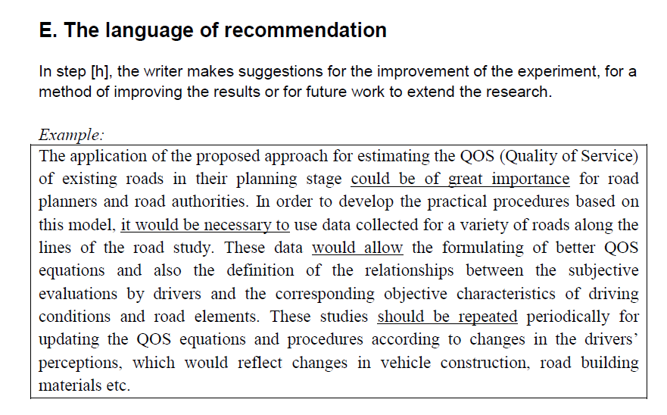

Slide 49
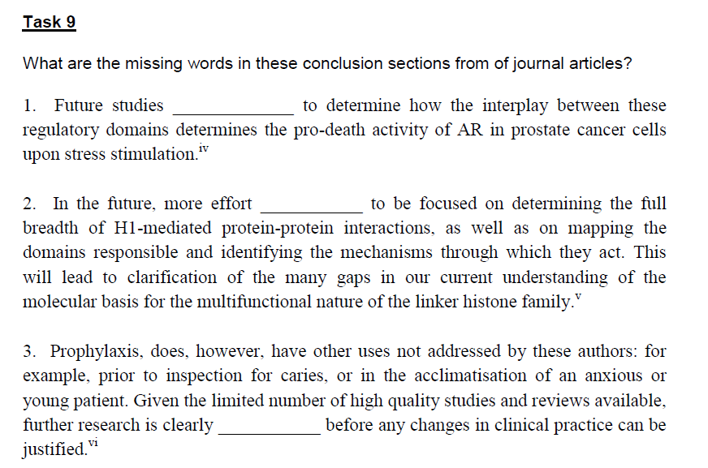
are needed/ needs / needed

